Slide 1
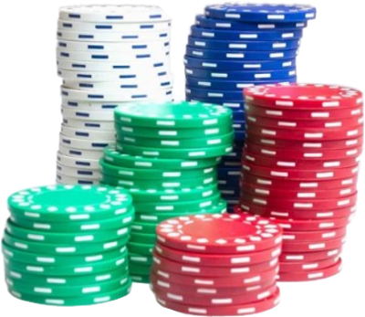
BLACKJACK PAYS 3 TO 2
Dealer must draw to
16 and stay on all 17’s
Double tap to HIT, Pinch out to SPLIT;
Swipe right to STAY, left to DOUBLE DOWN
$25
$50
$100
$250
$1K

Slide 2
PLAY AGAIN
$25
$50
$100
$250
$1K

Slide 3
SORRY
YOU
LOST
START OVER
$25
$50
$100
$250
$1K

Slide 4
← START
CLEAR BET
$25
$50
$100
$250
$1K

Slide 5
GOOD LUCK
$25
$50
$100
$250
$1K

